Slide 1

🏛️ JanSathi AI
Empowering Every Indian Citizen Through AI-Powered Public Welfare Assistance
An Omnichannel RAG Platform

Slide 2
Bridging the massive gap between millions of citizens and complex government bureaucracy through accessible, conversational AI.
"
"
The Vision Behind JanSathi AI

Slide 3


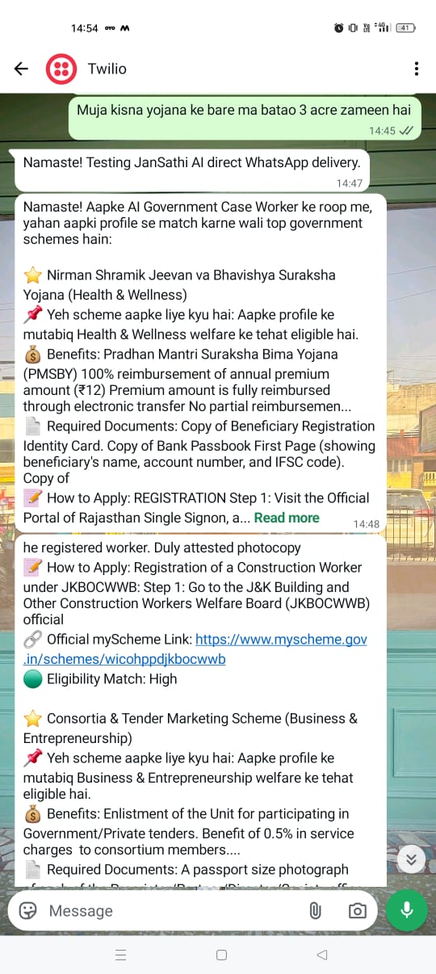
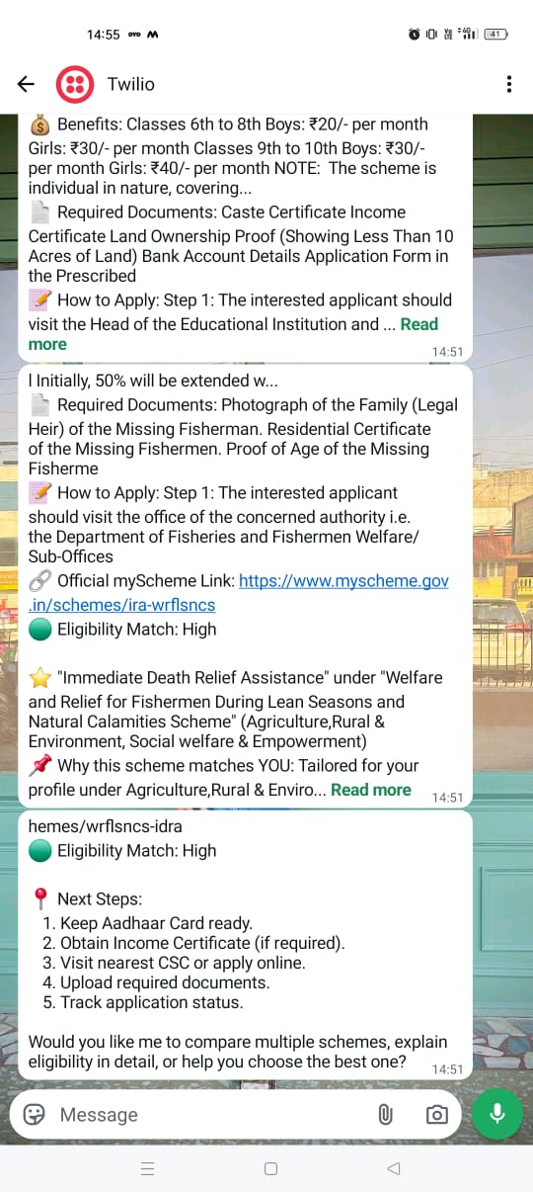
Meet Your AI Government Case Worker
JanSathi AI doesn't just search; it interacts and guides.
Interactive Profiling: Asks targeted missing profile questions before suggesting schemes.
Structured Recommendations: Explains exactly why a scheme matches you and highlights benefits.
Step-by-Step Guidance: Synthesizes actionable application steps and required documents.
Verified Integration: Provides direct official myScheme portal links.

Slide 4
Unmatched Scale & Data Depth
Comprehensive SQLite Database
Pre-loaded, auto-migrated B-Tree indexes spanning 10 core welfare domains.
3,400+
Powered by Domain Synonym Normalization, our engine intelligently maps colloquial terms (e.g., "Kisan", "12th class") to official government taxonomy instantly.
Verified Schemes

Slide 5


Core Differentiators
Zero-Hallucination RAG
Automated Ingestion
We enforce strict guardrails. Every response generated by our AI is anchored to the indexed SQLite database. If a scheme doesn't exist in the verified data, the AI will not invent it.
A 24-hour non-blocking background scheduler automatically fetches and ingests newly released schemes into the database, ensuring citizens always get up-to-date welfare information.

Slide 6






The Omnichannel Experience
Twilio WhatsApp
React Web Portal
Multilingual
Live chat via Twilio Sandbox. Citizens can get complete assistance using a simple messaging app they already know and trust.
A production-ready web UI allowing citizens to track matches, read scheme details, and schedule interactive application reminders.
Auto-detects queries in Hindi (Devanagari), Hinglish, or English, generating tailored responses in the citizen's preferred language.

Slide 7
The Technology Stack
Layer | Technology | Purpose & Execution
Frontend UI | React 18 & TypeScript | Responsive Web Portal, integrated directly with FastAPI for single-deployment routing.
Core Backend | FastAPI (Python 3.10+) | High-performance routing, intent processing, API endpoints, and webhook management.
AI & LLM Services | Gemini 2.0 & Sarvam AI | Gemini powers the Grounded RAG Case Worker; Sarvam handles natural, casual greetings.
Data & Search | SQLite (B-Tree Indexed) | Fast querying of the 3,400+ scheme dataset and conversation memory storage.

Slide 8

Real-World Impact
A rural farmer searching for "fasal sahayata" or a student looking for "Class 12 scholarships" no longer faces a wall of complex bureaucratic PDFs.
Through a simple WhatsApp message, they receive instant, perfectly matched guidance in their native language—complete with next steps and official links.

Slide 9



System Architecture
1. Omnichannel Input
2. Intent & RAG Engine
3. Actionable Output
Queries arrive via Twilio WhatsApp POST Webhook or the React Web Portal API.
FastAPI routes intent, searches indexed SQLite, and feeds top contexts to Gemini 2.0.
Citizen receives synthesized, multilingual, step-by-step application guidance.

Slide 10
Ready to Empower?
Thank you for exploring JanSathi AI with us.
github.com/your-repo/jansathi-ai
Made with ❤️ for Public Welfare

